Slide 1
IE 7280 Statistical methods in Engineering Final Project

Slide 2
Predicting House Sales Price using the housing data of Ames city in IOWA

Slide 3
Contents: 1) Introduction and problem statement 2) description of the data 3) Code implementation with steps 4) Model Fitting 5) Final conclusion

Slide 4
Problem statement: We are given a dataset consisting of house details in Ames, Iowa . Our problem statement is to build a predictive model that can be used to guide our customers on where, when and how to build a property with minimum expense to maximize profit during resale

Slide 5
Dataset Description: The dataset consists of the various features of the houses in AMES IOWA and the sales spread 2006-2010 The dataset consists of 2919 transactions that has happened at Ames and 80 features of the houses that has been sold. The columns consist of 36 numerical features and 43 categorical features

Slide 6
Code Implementation with steps
Step 1
check for null or missing values
Lot of columns were found to have null or missing values
Any column that had more than 40% null values was removed
Remaining columns mean was substituted for numerical columns.
Found variance and removed columns with very less variance as it does help in prediction

Slide 7
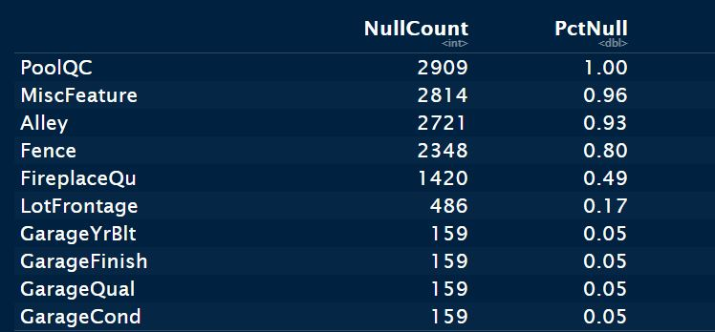

Slide 8
Step 2
Exploratory data analysis (EDA)
Plot the data to understand the data’s distribution

Slide 9
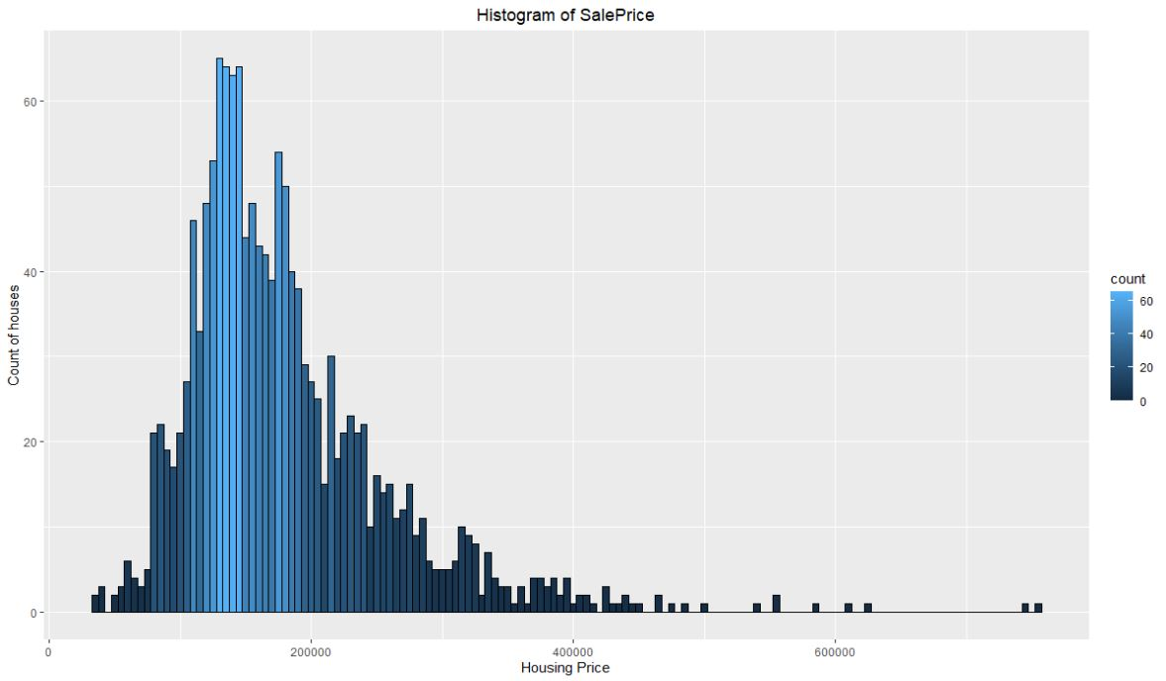
Target variable – sales price is heavily right skewed
Log transformation is needed

Slide 10
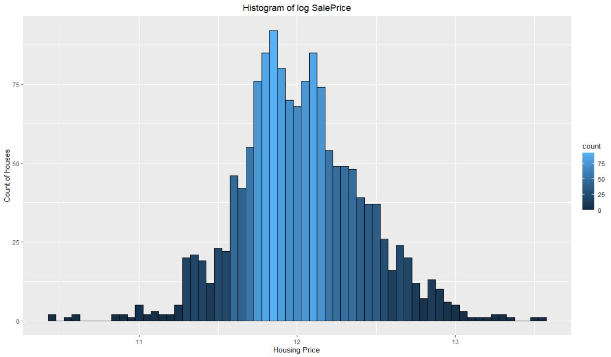
After log transformation the data follows a normal distribution

Slide 11
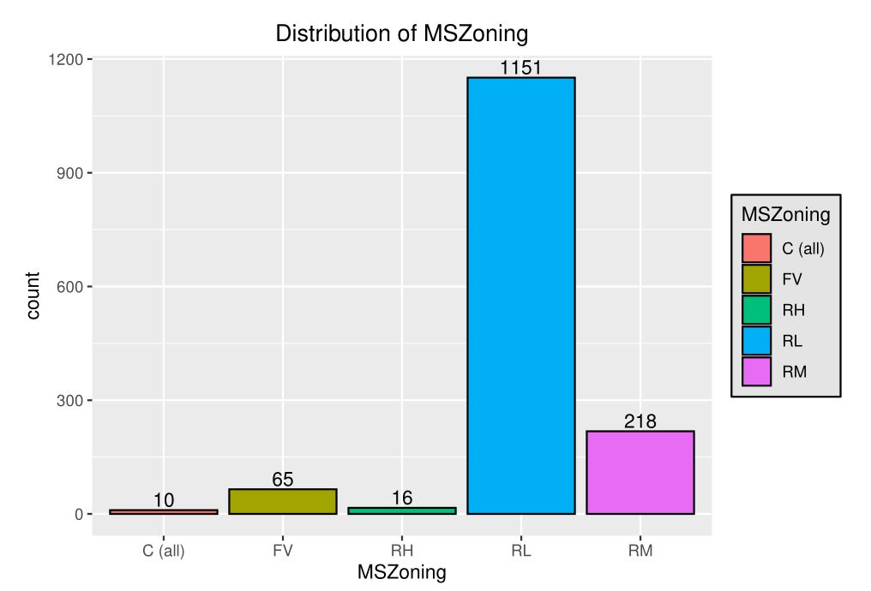
Distribution of MSzoning

Slide 12
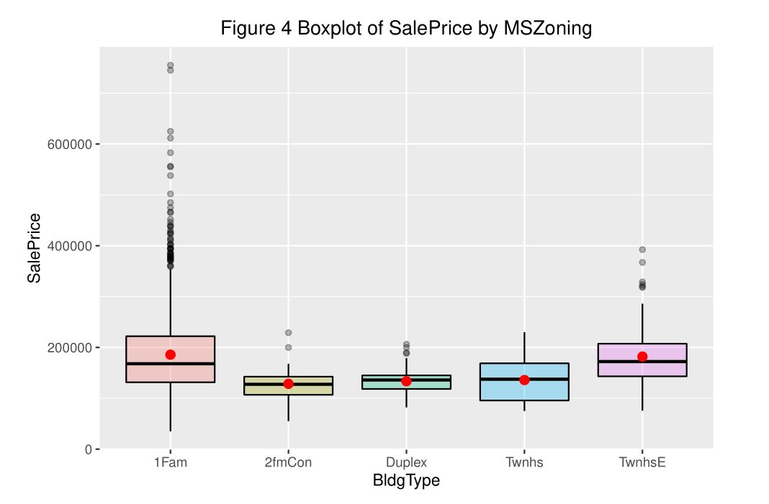
single family houses have the highest sales price

Slide 13
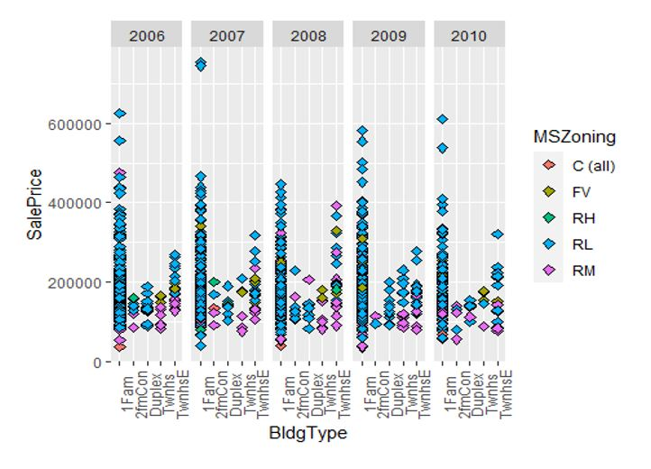

Slide 14
Step 4 :
FEATURE ENGINEERING

Slide 15
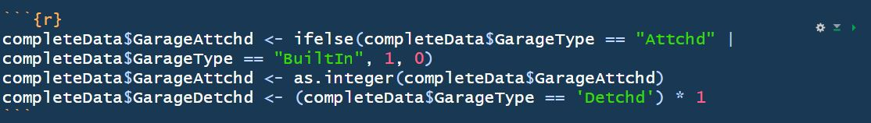
From the data we observed that the GarageType Column has several classifications. However, the classification can be grouped and made into 2 major classifications. We can group attchd, builtin category as a single group called ‘attached’ and the rest of the classifications under ‘Not-attached’.

Slide 16

The dataset that we have is till 2010 and sales made from 2006 to 2010 so we use 2010 as the present year and subtract with the respective year the house was built. We stored it as ‘year_since built’ column. We assume that this column will have a negative correlation as the resale value goes down (after discounting inflation ) with the number of years since it’s built increases.

Slide 17
Step 5:
Feature selection.
Found the correlation of the features.
The features that shows more than 70 % correlation were removed

Slide 18
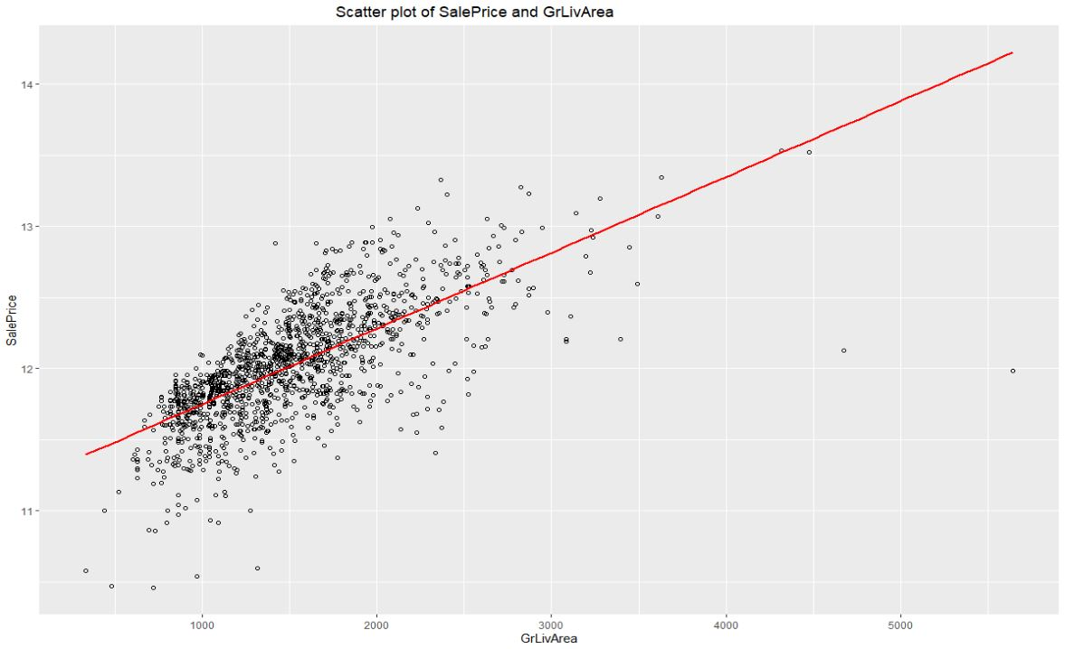
Scatter plot of Sales price vs Garage living area
It shows a positive correlation

Slide 19
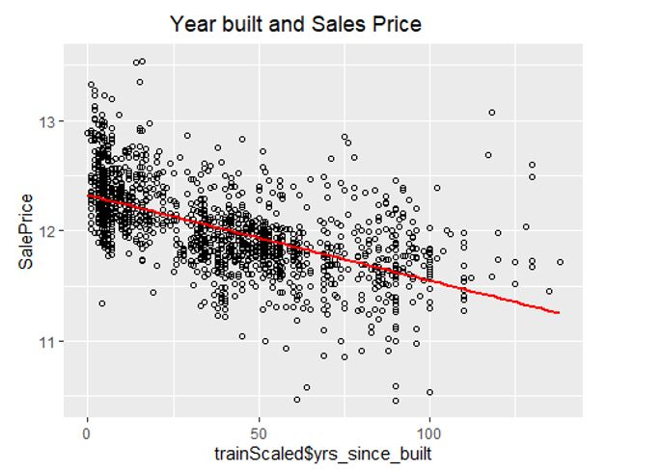
Scatter Plot of years since built and salesprice
We see a negative correlation

Slide 20
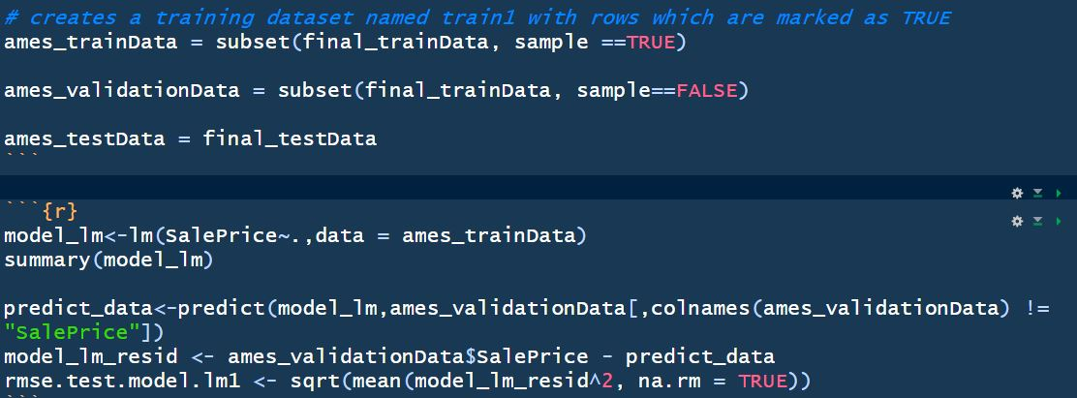
Model Fitting

Slide 21
Very good R squared
Very less p value
Hence we have a very good model

Slide 22
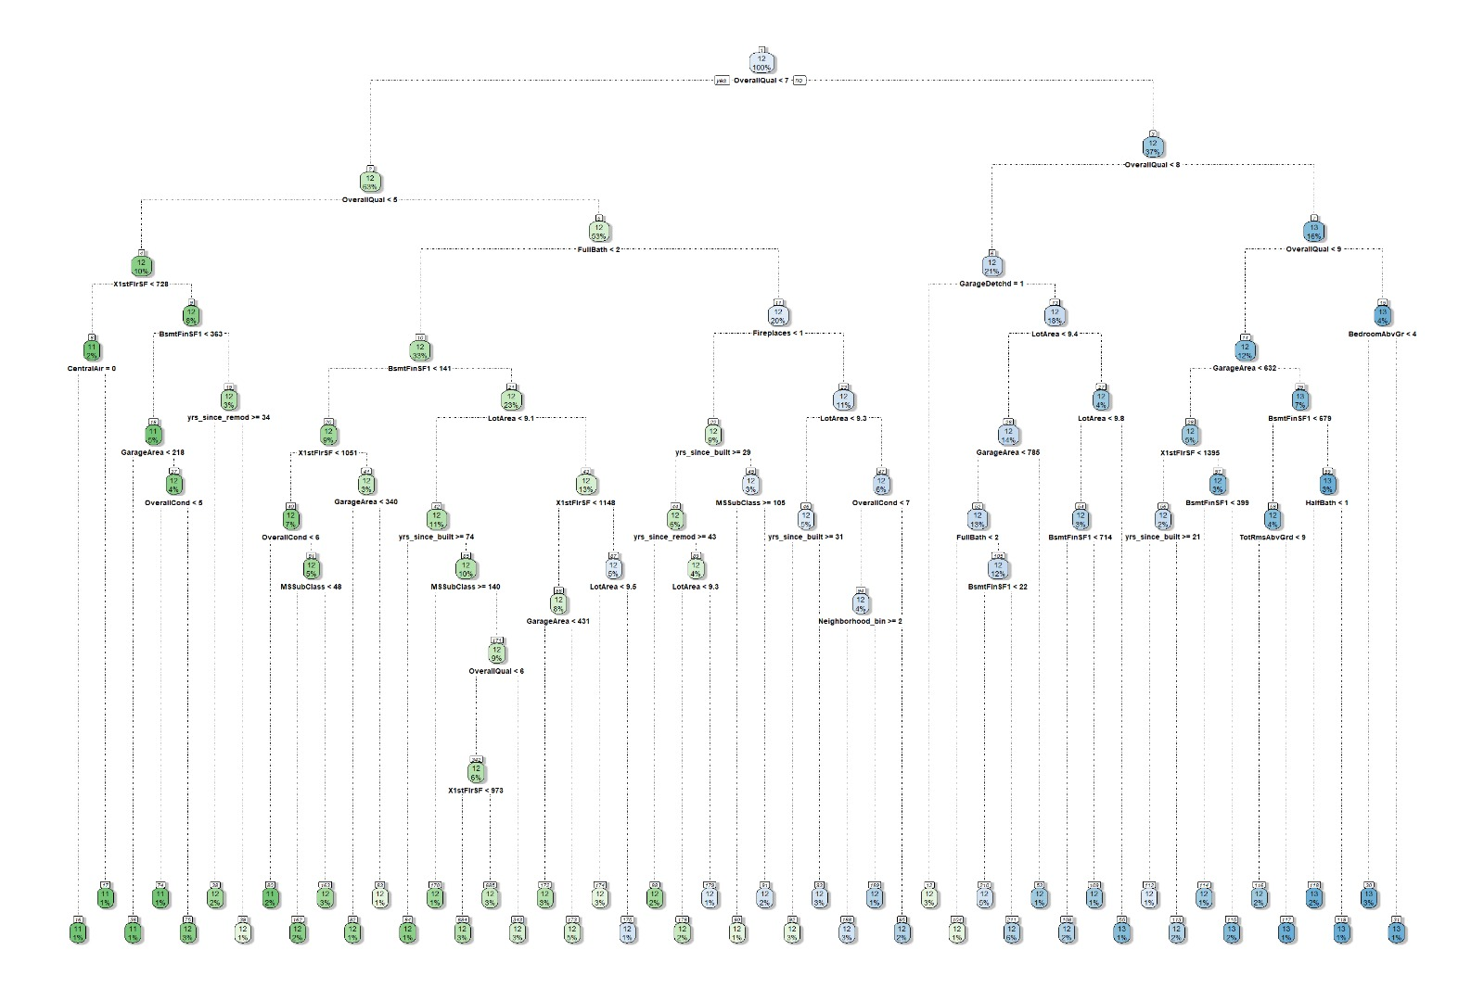
we have implemented a decision tree model for comparision
RMSE 0.2213

Slide 23
Problem Solved : Problem we are solving here is that, given a client wants to know the sales price of a house in a particular year with the type of house, garage requirement and any other feature that is available ( in our dataset) and we want to suggest him a house as per his requirement and maximize his profit if he decides to sell it in a particular year. Let’s assume for the sake of this argument that a client gives the specification which is exactly a entry in our test set then all we have to do is give them the necessary salesprice. We can do this for any custom values the clients may require using our model to predict the sales price.

Slide 24
Final Conclusion From our above analysis we conclude that we have found a way to provide the clients with the information as to which property to invest in or purchase and when and how much returns can they expect on selling the property. We used a Multiple Linear Regression model with RMSE 0.1703 to predict the sales price value and provide our client with the necessary details.

